Slide 1


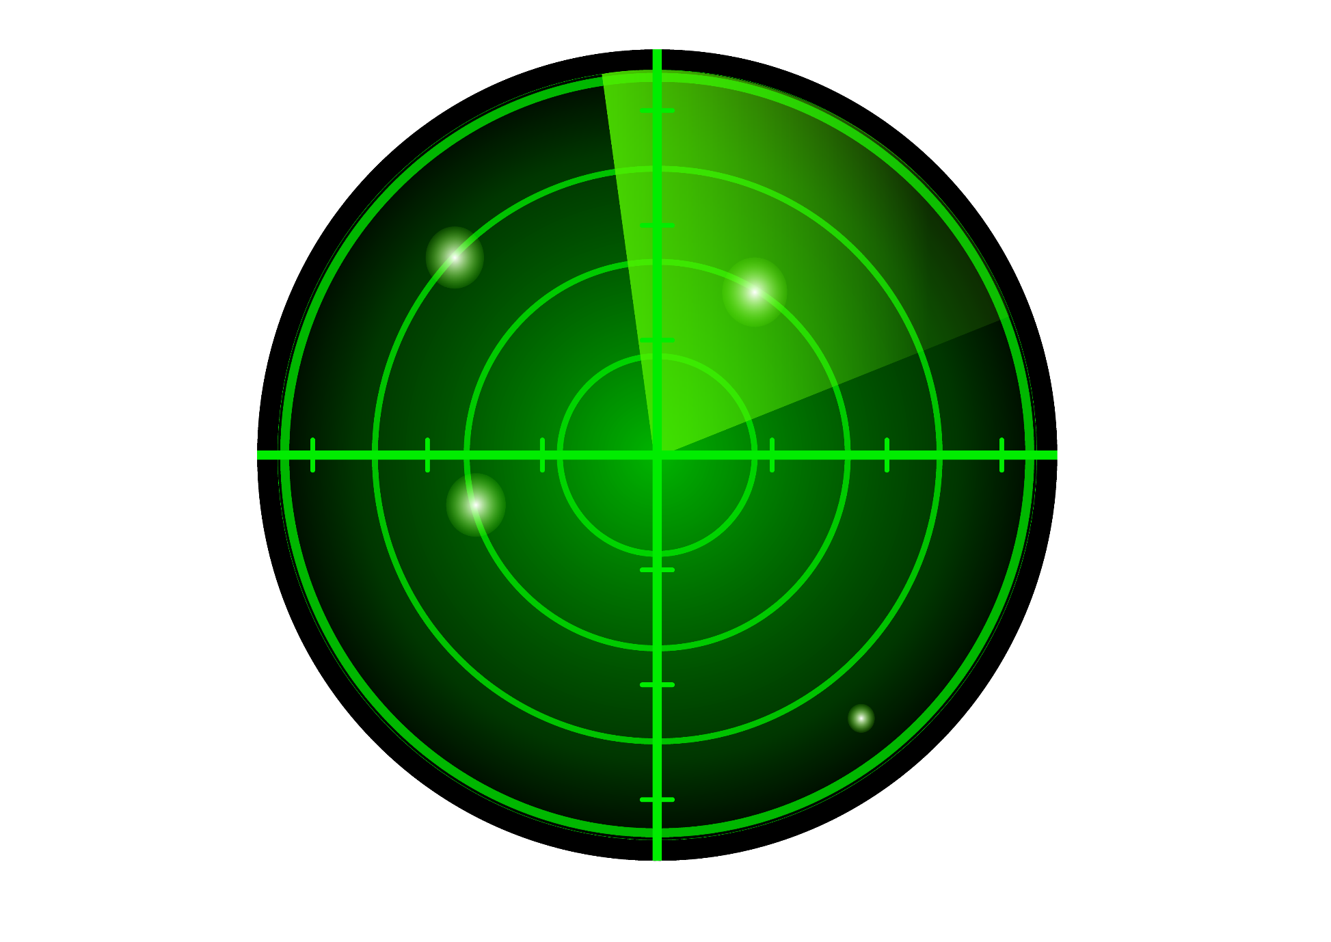

Deep Dive into Detection: Machine Learning Sonar Model for Mine vs Rock Identification
Presented by: Ashish Sharma,
UID :- 23MSM40001
Division: Mathematics, UIS

Slide 2
Contents
Introduction
Objective
Background
Challenges
Solution
Process of Model Preparation
Model Deployment
Conclusion
Q&A Session

Slide 3
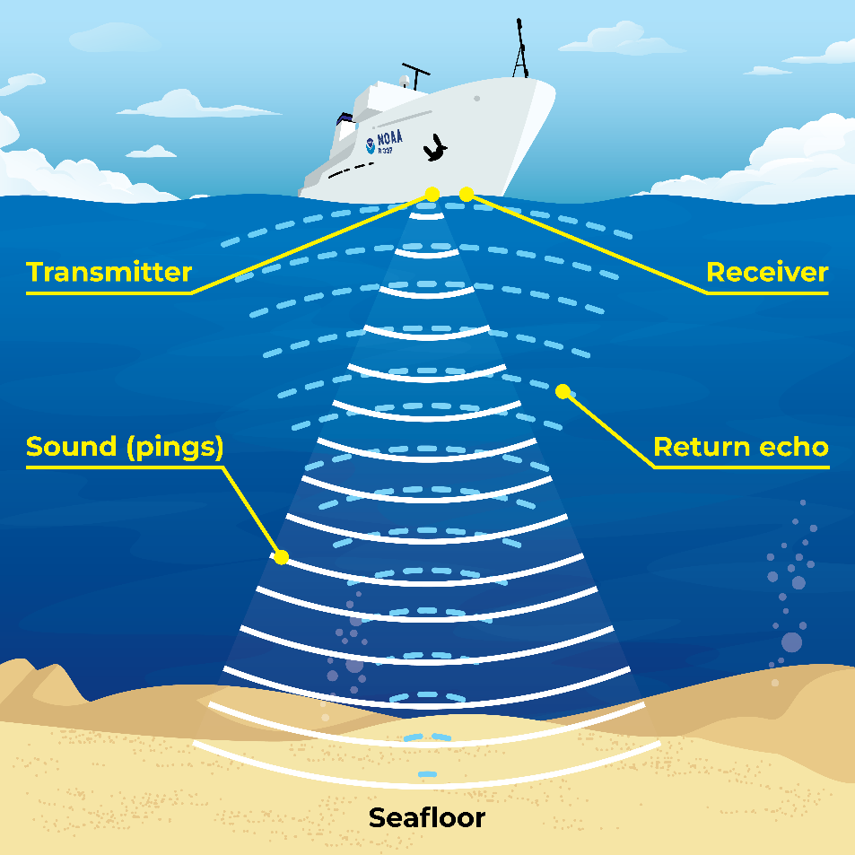
Introduction
Sonar (Sound Navigation and Ranging)
Sonar (Sound Navigation and Ranging) is a technique that uses sound propagation to navigate, communicate with, or detect objects on or under the surface of water.
Importance of Sonar in various applications: Military, underwater exploration, navigation, fisheries, etc.

Slide 4

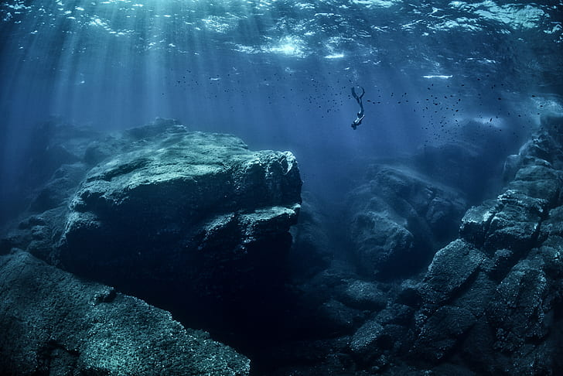

Objective of this Project
To develop a machine learning model that can distinguish between rocks and mines based on sonar data.

Slide 5
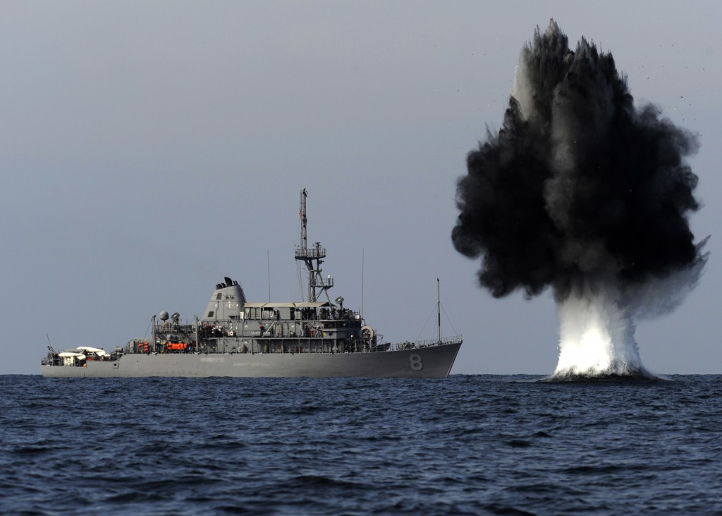
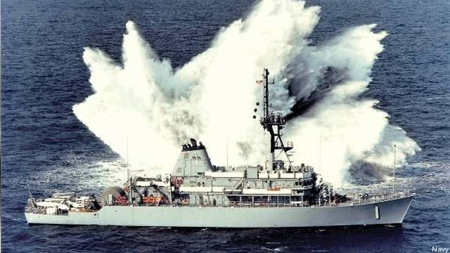
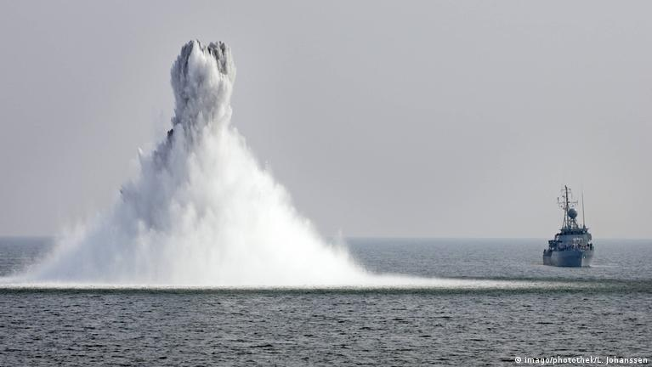
Background
Significance of Distinguishing Rocks from Mines in Underwater Environments
Distinguishing between rocks and mines in underwater environments is crucial for the safety of maritime activities such as navigation, fishing, and naval operations. Mines pose a significant threat to ships and submarines, leading to potential casualties and environmental damage.

Slide 6
Challenges in Traditional Methods of Object Detection Using Sonar
Ambiguity in Sonar Returns: Sonar signals reflected from underwater objects can be complex and ambiguous, making it challenging to differentiate between different types of objects, especially in cluttered environments.
Variability in Environmental Conditions: Factors such as water temperature, salinity, and turbidity can affect the propagation of sound waves in water, leading to variations in sonar returns and complicating object detection.
Limited Discriminative Power: Traditional signal processing techniques may struggle to extract discriminative features from sonar data, especially when dealing with subtle differences between objects.

Slide 7

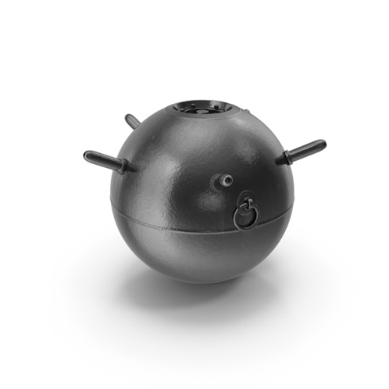

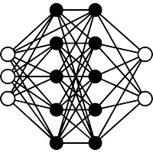
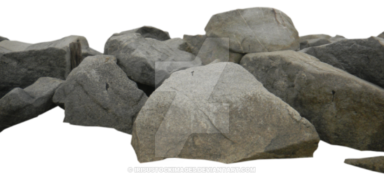
To create a ML model that can predict object is a Mine OR Rock
Input
Processing
Output
Predicts
Mine
SONAR
ML Model
Sea Rock

Slide 8

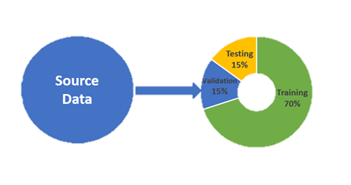



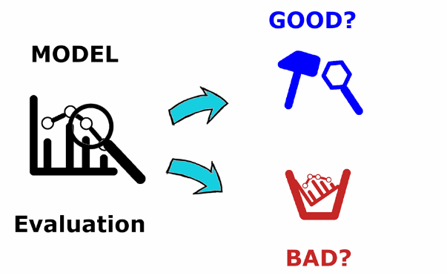


Process of Model Preparation
Source of Sonar Data
(Kaggle)
Data Preprocessing
& Splitting
Data Splitting
Feature Engineering
Model Evaluation
Accuracy on Model: - 76.19%
Model Training Training Set : - 90%
Testing Set : - 10%
Model Selection
(Logistic Regression is used in this model)
Data Quality Assurance

Slide 9
Model Deployment
This model can be deployed in various following real life applications :
Autonomous Underwater Vehicles (AUVs): Deploying the machine learning model on AUVs enables autonomous navigation and obstacle avoidance in underwater environments, enhancing the efficiency and safety of underwater exploration missions.
Maritime Security: Integrating the model into sonar-based surveillance systems enhances maritime security by detecting and identifying potential threats such as mines in strategic waterways and coastal regions.
Environmental Monitoring: The model can be deployed for monitoring and assessing underwater ecosystems by detecting and mapping submerged objects such as rocks and debris that may impact marine biodiversity.

Slide 10
Model Deployment
This model can be deployed and integrated on ships in the following ways:
On-Board Implementation: Embedding the machine learning model directly onto the hardware of underwater vehicles or sonar devices allows for real-time processing and decision-making without relying on external computing resources.
Cloud-Based Deployment: Leveraging cloud infrastructure enables scalable and centralized deployment of the model, facilitating remote access, management, and updates across multiple platforms and locations.
Multi-Sensor Fusion: Integrating the model with other sensor modalities such as cameras, lidar, or hydrophones enhances object detection capabilities by combining complementary information from different sensor sources.

Slide 11
Conclusion
1. Achievements:
Accuracy of my model: 76.19%
The machine learning model has demonstrated promising performance in distinguishing between rocks and mines based on sonar data, achieving notable accuracy metrics on both the training and testing sets.
2. Validation of Approach: The high accuracy achieved on the testing set validates the effectiveness of the chosen approach, including feature engineering, model selection, and training strategies, in addressing the problem of sonar-based object detection.
3. Potential for Real-World Deployment: The success of the model in accurately classifying objects in underwater environments highlights its potential for real-world deployment in various applications, including maritime security, environmental monitoring, and underwater exploration.

Slide 12
Q&A SESSION
I'll wrap up this presentation with a Q&A session. Please feel free to ask any questions you may have, and I'll be happy to clarify any doubts.

Slide 13
Thank You
Prepared by : Ashish Sharma, 23MSM40001
Division: Mathematics, UIS

